Slide 1
Understanding World Happiness
Emily Geller

Slide 2
Question
‘What qualities impact a country’s average level of happiness?’
UN’s World Happiness Report, 2017

Slide 3
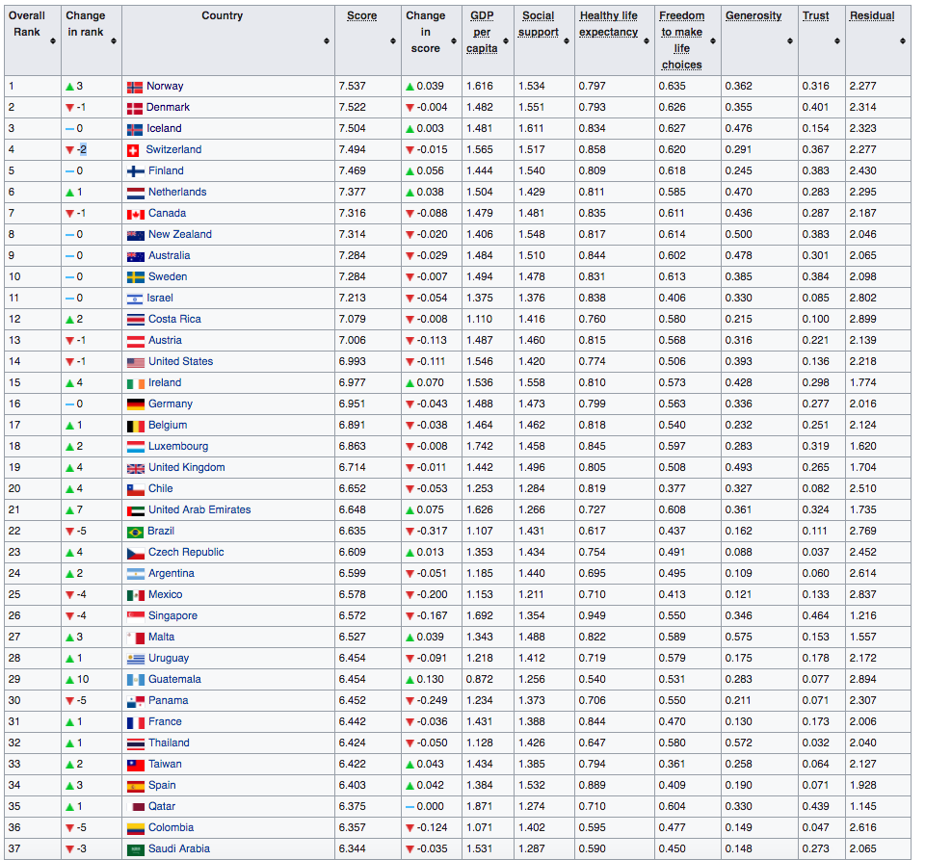
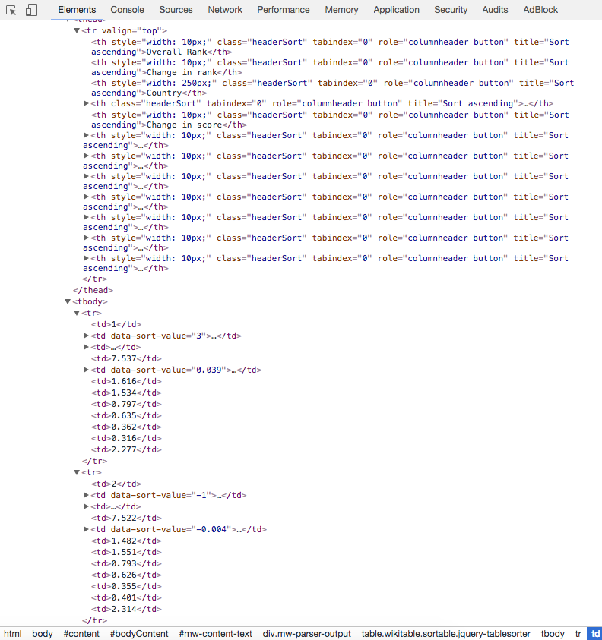
Webscraping: World Happiness Dataset
World Happiness results from Wikipedia
https://en.wikipedia.org/wiki/World_Happiness_Report
155 Participating Countries
6 Scraped Features
Notes:
-Used beautiful soup to scrape html
- pandas read_html method to create a dataframe

Slide 4
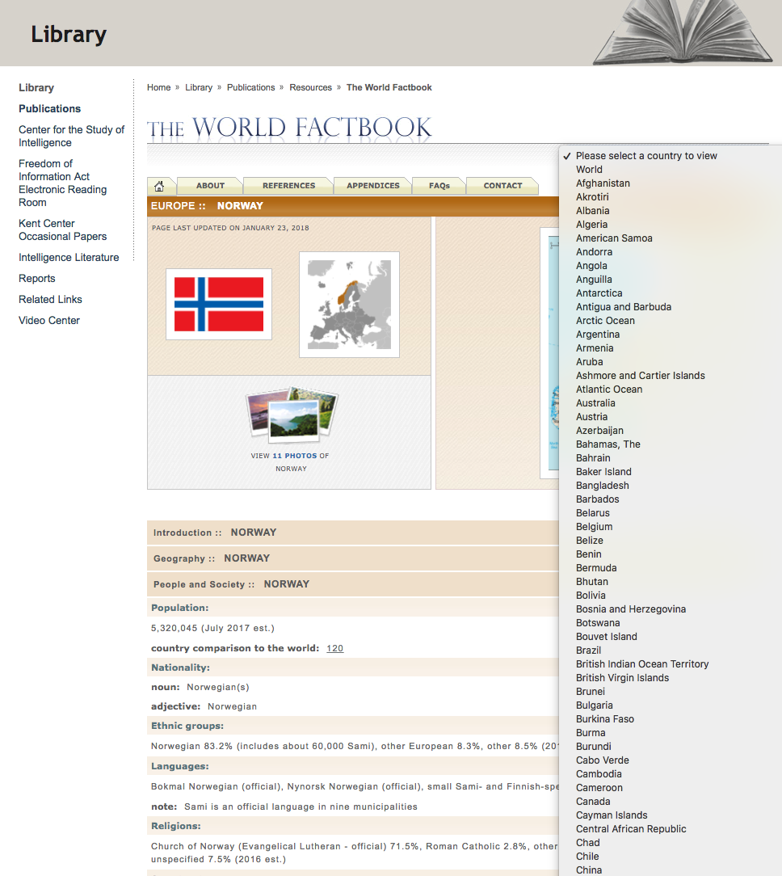
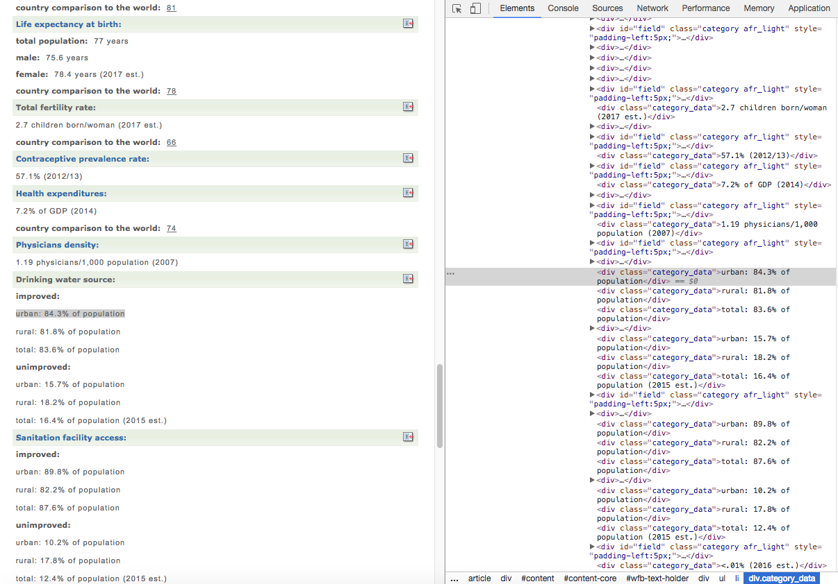
Webscraping: World Facts Dataset
World Facts from CIA’s World Fact Book
https://www.cia.gov/library/publications/the-world-factbook/
20 Scraped Features
Notes:
- Found selector that contained country to url mappings
- Scraped this, found pattern in world facts url
- Created a function to build each url using this mapping
- Created a function to scrape each feature on each country page
- Cleaned data as it was scraped
- Non-hierarchical structure led to some tricky scraping
- Non standardized across countries
- Features chosen based on intuition. Could expand list.

Slide 5
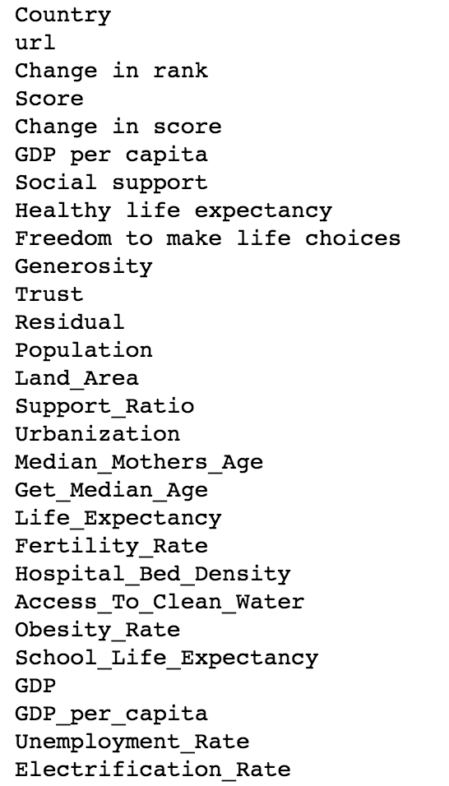
Putting it all together
Dataset 1:
World Happiness Results
Dataset 2:
World Facts
Notes:
Joined two datasets together on Country name
Differing Country names
Missing values

Slide 6
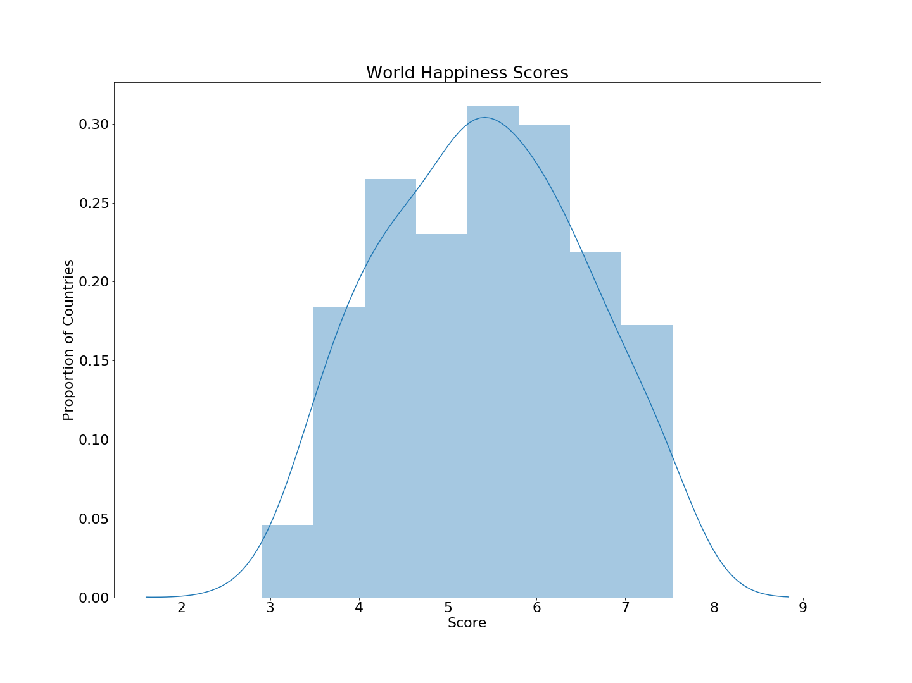
World Happiness Results
Burundi (2.91)
Tanzania (3.35)
Norway (7.54)
Denmark (7.52)
Notes:
US: 6.99 #14
Aus: 7.28 #9

Slide 7
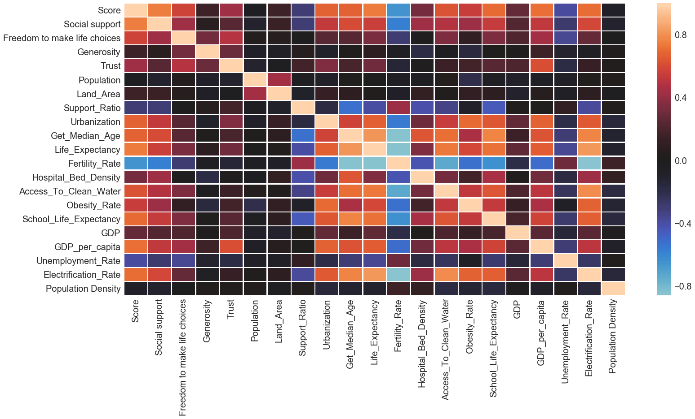
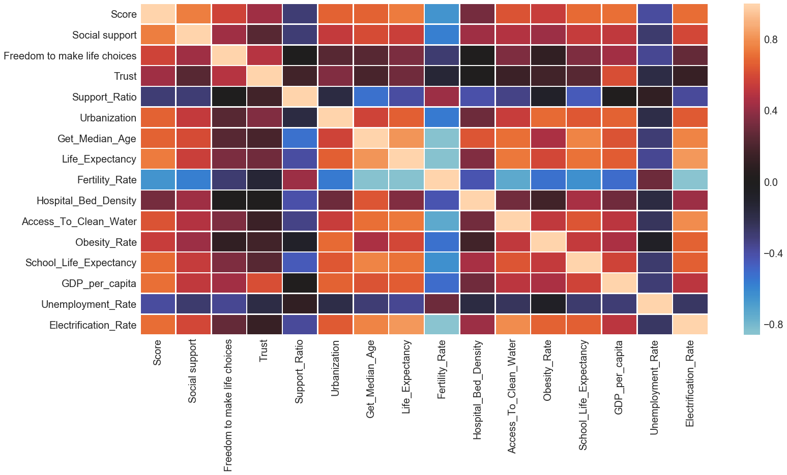
Feature and Target Correlations
Notes:
Spend more time on slide. Get rid of numbers. Explain colors and examples

Slide 8
Setting up for OLS Regression
Features
First Model Results:
R² = 0.828
Mse = 0.214
High coefficient pvalues
Social support
Freedom to make life choices
Trust
Support_Ratio
Urbanization
Get_Median_Age
Life_Expectancy
Fertility_Rate
Hospital_Bed_Density
Access_To_Clean_Water
Obesity_Rate
School_Life_Expectancy
Unemployment_Rate
Electrification_Rate
logGDP_per_capita
Social support
Freedom to make life choices
Trust
Support_Ratio
Urbanization
Get_Median_Age
Life_Expectancy
Fertility_Rate
Hospital_Bed_Density
Access_To_Clean_Water
Obesity_Rate
School_Life_Expectancy
Unemployment_Rate
Electrification_Rate
logGDP_per_capita
Social support
Freedom to make life choices
Life_Expectancy
School_Life_Expectancy
logGDP_per_capita
Target
Happiness Score
Notes:
Mention which ones I kept

Slide 9
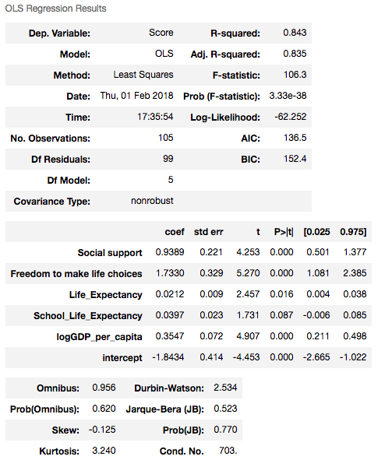
OLS Regression Results
Fit
Relationship
Significance
Residuals
mse(test) ~ 0.23
Notes:
Social support + Freedom to make life choices + Life Expectancy + School Life Expectancy + log(GDP per capita)

Slide 10
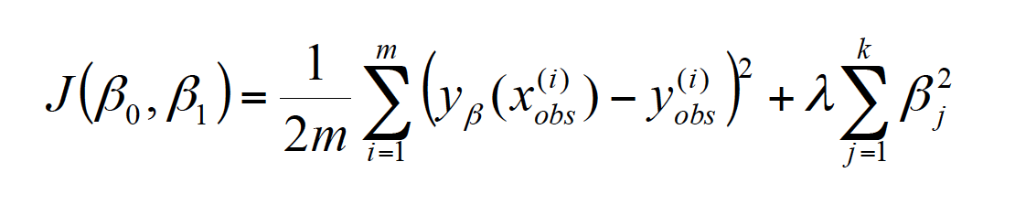
Cross Validation and Regularization
10-Fold Cross Validation:
r² = 0.7371
mse = 0.2430
Cross Validated and Regularized:
RidgeCV:
r² = 0.8005
mse = 0.2780
α = 0.001
Notes:
Put things I didn’t use in different slides

Slide 11
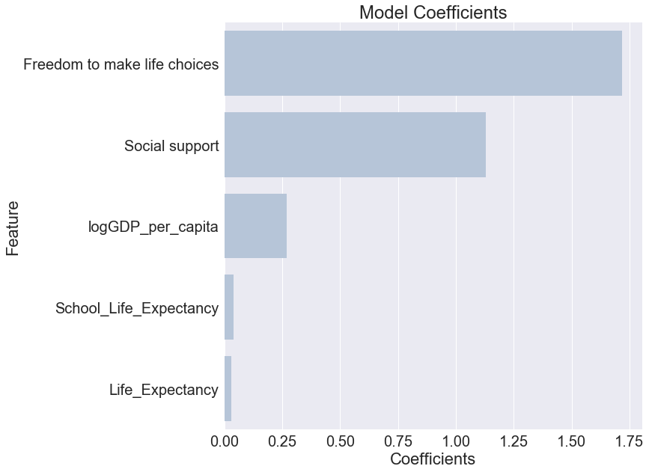
Coefficients
Notes:
100% change in GDP per capita corresponds to 0.25 change in score

Slide 12
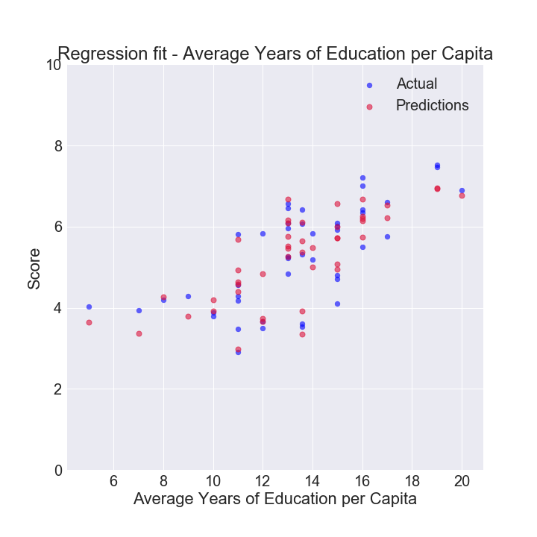
Prediction Power
Notes:
Change colors. Make bigger and choose one

Slide 13
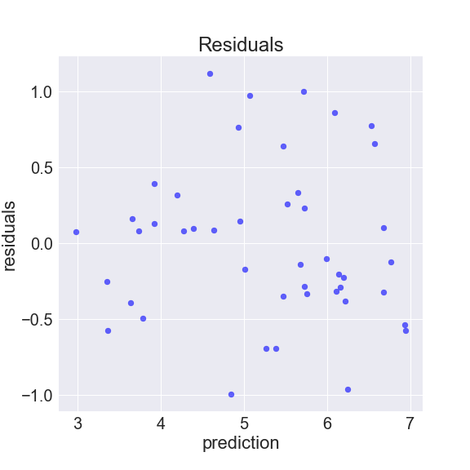
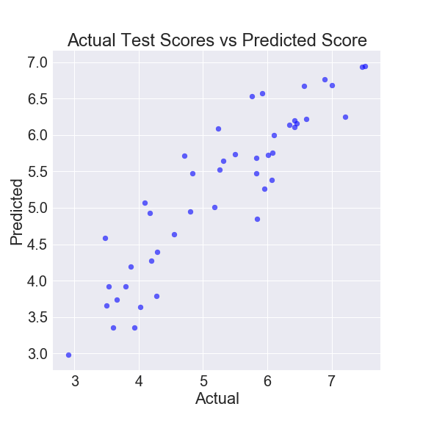
Residuals

Slide 14
Conclusions
Key features:
Social support
Freedom to make life choices
Life Expectancy
School Life Expectancy
log(GDP per capita)
Happiness
Score

Slide 15
Next Steps
Include regionality in analysis
Include more observations from past years
Consider including more features

Slide 16
Questions

Slide 17
Appendix

Slide 18
Putting it all together
Dataset 1:
World Happiness Results
Dataset 2:
World Facts
Joined two datasets together on Country name
Differing Country names
Missing values

Slide 19
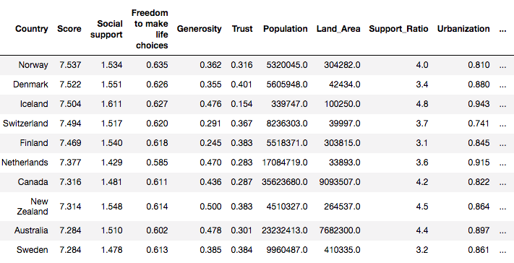
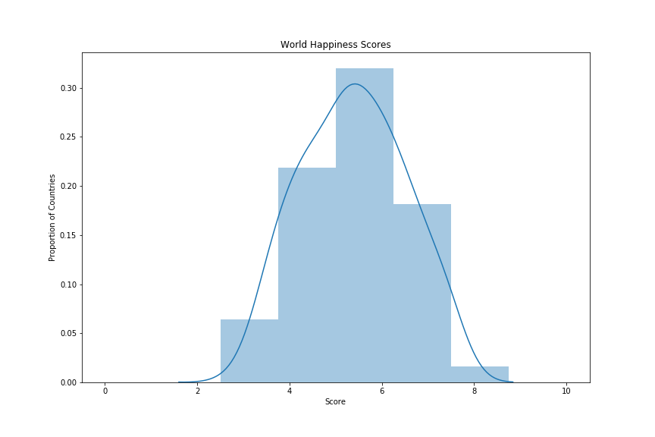
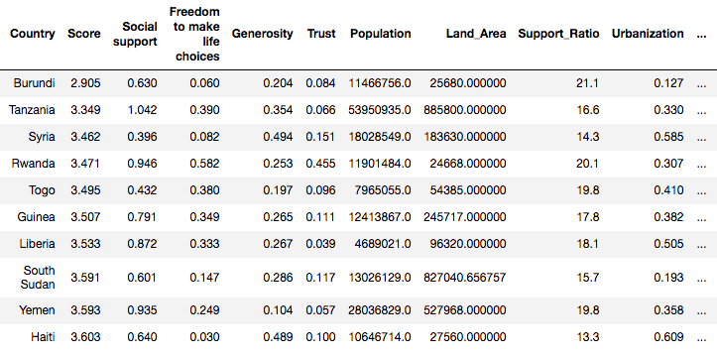
World Happiness Results
Highest Scoring Countries
Lowest Scoring Countries
Notes:
Make plot bigger and point to top 2 and bottom 2

Slide 20
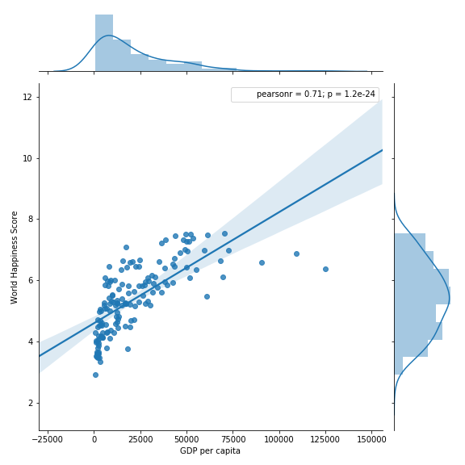
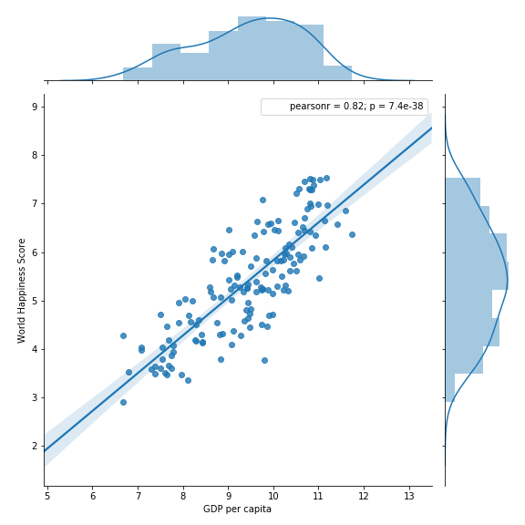
GDP per capita
GDP per capita
Log(GDP per capita)
Notes:
A 10% increase in GDP
0.029 increase in Score

Slide 21
OLS Regression
Target interpretation
r²: highest | 86% var(Score) can be explained
adj r²: highest | slightly penalized by large coefficients
F-statistic: low | relationship is unlikely to be due to chance
Log-Likelihood: higher | likely to get observed Score values
Feature interpretation
p-values : lower | features contribute to the model
Error interpretation
P(Omnibus): higher | ℇ is relatively normally distributed
Skew: negative | data is slightly left-skewed
Kurtosis: ~3 | data has similar peakedness to a Normal Distribution
P(JB): higher | ℇ is relatively normally distributed
Durbin-Watson: ~2 | Very small amount of autocorrelation
mse(test) ~ 0.23
Notes:
Social support + Freedom to make life choices + Life Expectancy + School Life Expectancy + log(GDP per capita)
* Replace with simpler slide. Put this in appendix

Slide 22

Cross Validation and Regularization
10-Fold Cross Validated:
r² = 0.7371
mse = 0.2430
Cross Validated and Regularized:
RidgeCV:
r² = 0.8005
mse = 0.2780
Alpha = 0.001
LassoCV:
r² = 0.7960
mse = 0.2842
Alpha = 0.007
ElasticNetCV:
r² = 0.7400
mse = 0.2841
Alpha1 = 1e5
Alpha2 = 1e3
Notes:
Put things I didn’t use in different slides

Slide 23
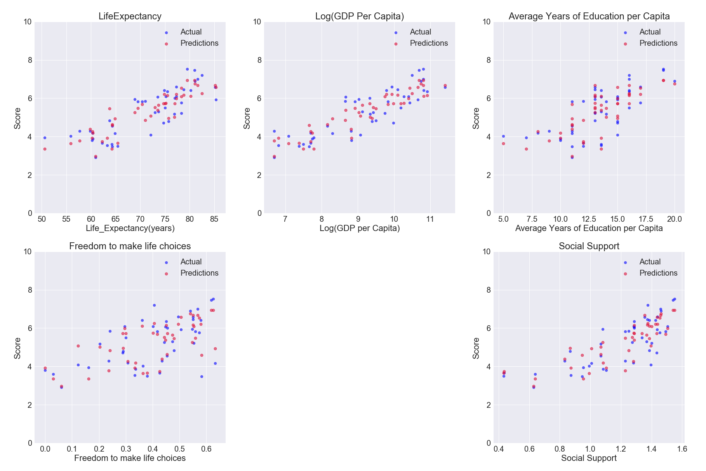
Features vs Predicted Target
Notes:
Change colors. Make bigger and choose one

Slide 24
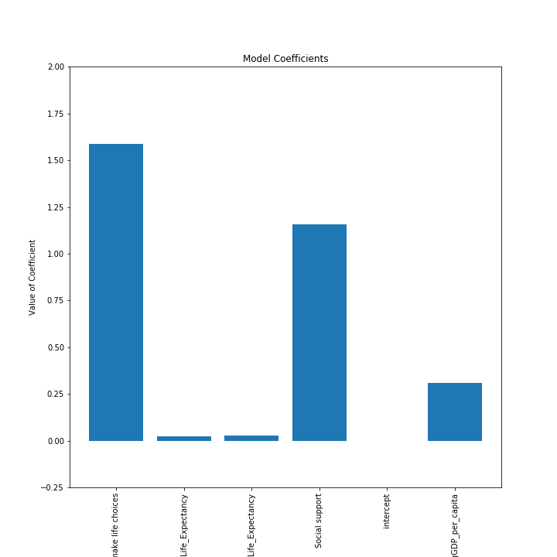
Coefficients
Coefficients | Feature
1.588459 | Freedom to make life choices
1.155636 | Social support
0.308490 | logGDP_per_capita
0.026942 | School_Life_Expectancy
0.023984 | Life_Expectancy
0.000000 | intercept
Different scales:
0-1: Freedom to make life choices
Social Support
Log GDP per capita
Life Expectancy
School Life Expectancy
Hospital Bed Density
Notes:
Social support + Freedom to make life choices + Life Expectancy + School Life Expectancy + log(GDP per capita)
Get rid of table and make graph bigger. Flip so names on y axis

